Slide 1
04 | Decision Trees
Cynthia Rudin | MIT Sloan School of Management

Slide 2
Decision Trees
Why trees?
Interpretable, intuitive, popular in medical applications because they mimic the way people like to reason. Logical models.
Powerful, nonlinear
Notes:
I have a love hate relationship with decision trees. I’ll tell you the disadvantages later on. Let me first let you admire the nice things about them.

Slide 3
Decision Trees
Example: Will the customer wait for a table at a restaurant?
OthOptions: Other options, True if there are restaurants nearby.
Weekend: This is true if it is Friday, Saturday or Sunday.
Area: Does it have a bar or other nice waiting area to wait in?
Plans: Does the customer have plans just after dinner?
Price: This is either $, $$, $$$, or $$$$
Precip: Is it raining or snowing?
Genre: French, Mexican, Thai, or Pizza
Wait: Wait time estimate: 0-5 min, 6-15 min, 16-30 min, or 30+
Crowded: Whether there are other customers (no, some, or full)
Credit: Adapted from Russell and Norvig

Slide 4
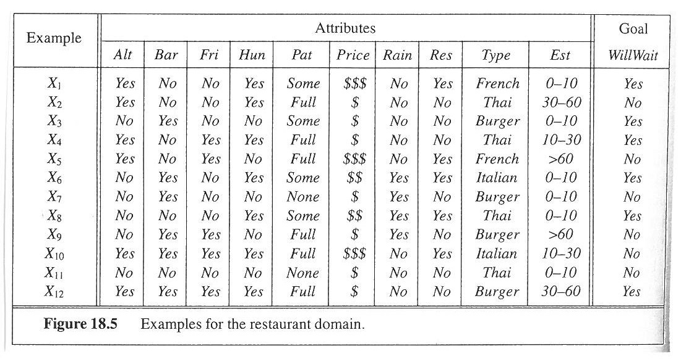
Decision Trees
Example: Will the customer wait for a table at a restaurant?
 | OthOptions | Weekend | Area | Plans | Price | Precip | Genre | Wait | Crowded | Stay?
x₁ | Yes | No | No | Yes | $$$ | No | French | 0-5 | some | Yes
x₂ | Yes | No | No | Yes | $ | No | Thai | 16-30 | full | No
x₃ | No | No | Yes | No | $ | No | Pizza | 0-5 | some | Yes
x₄ | Yes | Yes | No | Yes | $ | No | Thai | 6-15 | full | Yes
x₅ | Yes | Yes | No | No | $$$ | No | French | 30+ | full | No
x₆ | No | No | Yes | Yes | $$ | Yes | Mexican | 0-5 | some | Yes
x₇ | No | No | Yes | No | $ | Yes | Pizza | 0-5 | none | No
x₈ | No | No | No | Yes | $$ | Yes | Thai | 0-5 | some | Yes
x₉ | No | Yes | Yes | No | $ | Yes | Pizza | 30+ | full | No
x₁₀ | Yes | Yes | Yes | Yes | $$$ | No | Mexican | 6-15 | full | No
x₁₁ | No | No | No | No | $ | No | Thai | 0-5 | none | No
x₁₂ | Yes | Yes | Yes | Yes | $ | No | Pizza | 16-30 | full | Yes

Slide 5
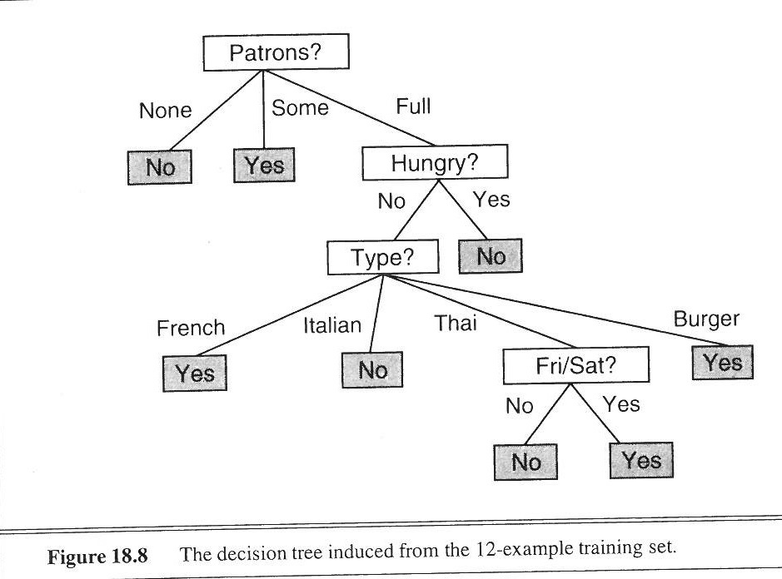
Decision Trees
Example: Will the customer wait for a table at a restaurant?
Crowded?
Full
None
Some
Plans?
No
Yes
No
Yes
No
Genre?
Thai
French
Weekend?
Yes
Mexican
Pizza
No
Yes
No
Yes
No
Yes
Notes:
Now you can see why people like them so much

Slide 6
Standard Way to Build a Decision Tree
Start at the top of the tree.
Grow it by “splitting” features one by one. To split, look at how “impure” the node is.
Assign leaf nodes the majority vote in the leaf.
At the end, go back and prune leaves to reduce overfitting.
Why is this a good way to build a tree?
Notes:
It’s not. It’s really what I call a hack. But it works really well. I have to warn you that C4.5 and CART are not elegant by any means that I
can dene elegant. But the resulting trees can be very elegant. Plus there are
2 of the top 10 algorithms in data mining that are decision tree algorithms! So
it's worth it for us to know what's under the hood... even though, well... let's
just say it ain't pretty.

Slide 7
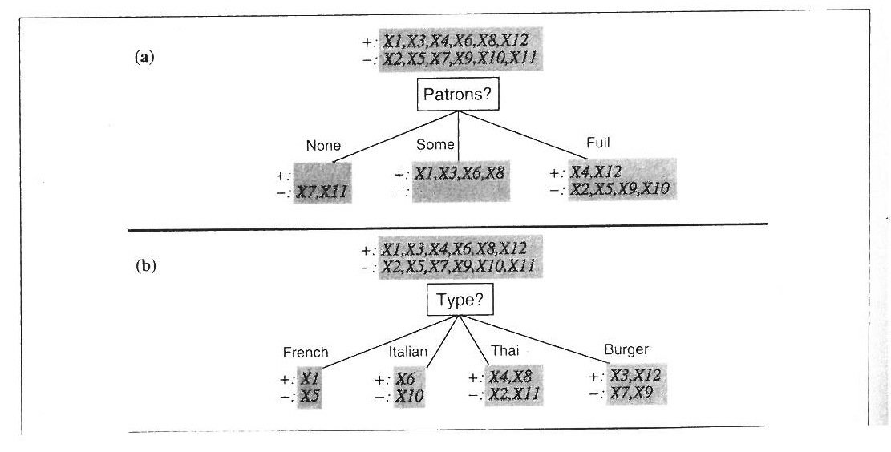
Which of these two features should we split on? Which gives the most information about whether the customer will wait?
+ x₁,x₃,x₄,x₆,x₈,x₁₂
- x₂,x₅,x₇,x₉,x₁₀,x₁₁
+ x₁,x₃,x₄,x₆,x₈,x₁₂
- x₂,x₅,x₇,x₉,x₁₀,x₁₁
Genre?
Crowded?
French
Pizza
Thai
Full
+ x₁
- x₅
+ x₃,x₁₂
- x₇,x₉
None
Some
+ x₄,x₈
- x₂, x₁₁
+
- x₇,x₁₁
+ x₁,x₃,x₆,x₈
-
+ x₄,x₁₂
- x₂,x₅,x₉,x₁₀
Mexican
+ x₆
- x₁₀
Notes:
So it’s obvious here, because Genre tells us pretty much nothing by itself. You have an equal number of customers waiting and not waiting in each of the four types.

Slide 8
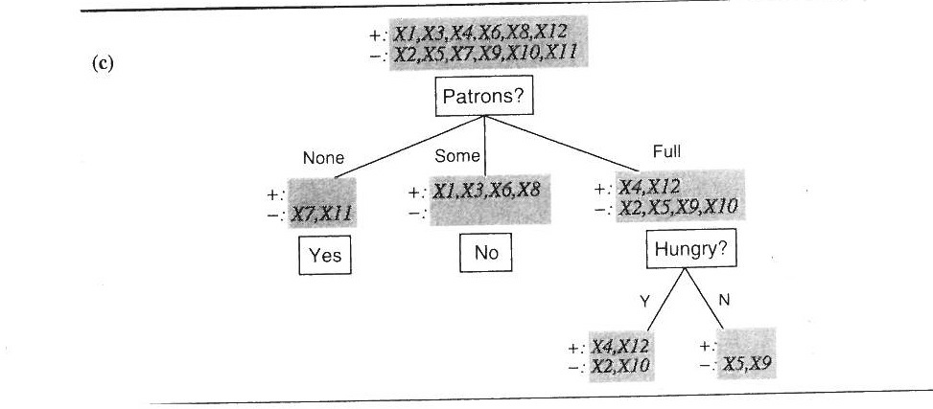
Next we’ll split on Plans
+ x₁,x₃,x₄,x₆,x₈,x₁₂
- x₂,x₅,x₇,x₉,x₁₀,x₁₁
Crowded?
None
Some
Full
+
- x₇,x₁₁
+ x₁,x₃,x₆,x₈
-
+ x₄,x₁₂
- x₂,x₅,x₉,x₁₀
Yes
No
Plans?
No plans
Yes plans
+
- x₅,x₉
+ x₄,x₁₂
- x₂,x₁₀
No
Notes:
So it’s obvious here, because Type tells us pretty much nothing by itself. You have an equal number of customers waiting and not waiting in each of the four types.

Slide 9
Information
“Information” from observing the occurrence of an event
= the number of bits needed to encode the probability of the event.
If an event has probability p, we need –log₂(p) bits.
A coin flip from a fair coin encodes 1 bit of information.
p=1/2, and then –log₂(1/2) = 1 bit
For an event with probability 1, we don’t need any bits.
p=1, and then –log₂(1) = 0 bits

Slide 10

If we had many events, with probabilities [p_{1,…,}p_{M}], what is their mean information?
If there are only 2 events (binary) with probabilities p and 1-p,
If the probabilities are ½ and ½:
If the probabilities are .99 and .01:
Notes:
If any of the probabilities are close to 0, the entropy is close to 0, which is what we want.

Slide 11
If we had many events, with probabilities [p_{1,…,}p_{M}], what is their mean information?
If there are only 2 events (binary) with probabilities p and 1-p,
If the probabilities are ½ and ½:
If the probabilities are .99 and .01:
Notes:
So that’s just using the definition of what an average is. So that’s fine. You just weight the information values by their probabilities of occuring

Slide 12
If we had many events, with probabilities [p_{1,…,}p_{M}], what is their mean information?
If there are only 2 events (binary) with probabilities p and 1-p,
If the probabilities are ½ and ½:
If the probabilities are .99 and .01:
Notes:
Write in the definition of information.

Slide 13
If we had many events, with probabilities [p_{1,…,}p_{M}], what is their mean information?
If there are only 2 events (binary) with probabilities p and 1-p,
If the probabilities are ½ and ½:
Entropy
If the probabilities are .99 and .01:
Notes:
This is called Entropy.

Slide 14
If we had many events, with probabilities [p_{1,…,}p_{M}], what is their mean information?
If there are only 2 events (binary) with probabilities p and 1-p,
If the probabilities are ½ and ½:
If the probabilities are .99 and .01:
Notes:
Just following the formula there. Just the definition up here applied to the case where the probabilities are p and 1-p.

Slide 15
If we had many events, with probabilities [p_{1,…,}p_{M}], what is their mean information?
If there are only 2 events (binary) with probabilities p and 1-p,
If the probabilities are ½ and ½:
If the probabilities are .99 and .01:
Notes:
Entropy is 1, but we knew that.

Slide 16
If we had many events, with probabilities [p_{1,…,}p_{M}], what is their mean information?
If there are only 2 events (binary) with probabilities p and 1-p,
If the probabilities are ½ and ½:
If the probabilities are .99 and .01:
Notes:
Entropy is much smaller. Anytime you have a very low probability in there, the entropy is going to be really low. Let’s relate this to your sort of usual intuition about entropy.

Slide 17

Entropy

Slide 18
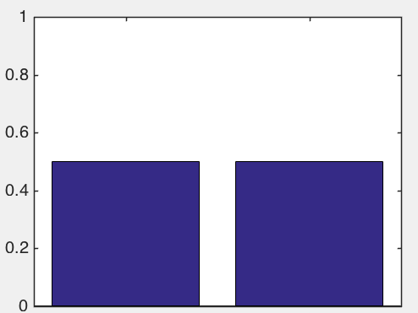
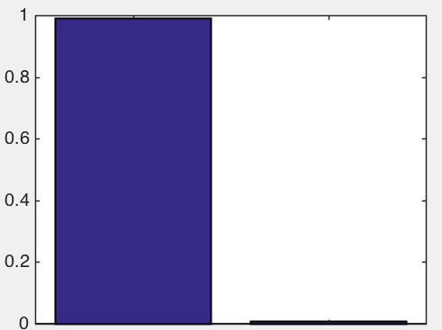
If we had many events, with probabilities [p_{1,…,}p_{M}], what is their mean information?
If there are only 2 events (binary) with probabilities p and 1-p,
If the probabilities are ½ and ½:
If the probabilities are .99 and .01:
Notes:
If any of the probabilities are close to 0, the entropy is close to 0, which is what we want.

Slide 19
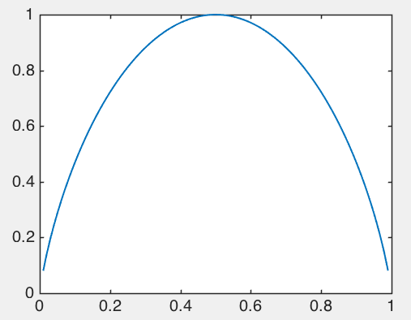
Entropy [p,1-p]
Probability p

Slide 20
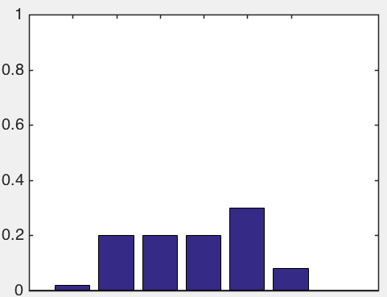
If the probabilities are [.02,.2,.2,.2,.3,.08]
H([.02,.2,.2,.2,.3,.08]) = 2.3186

Slide 21
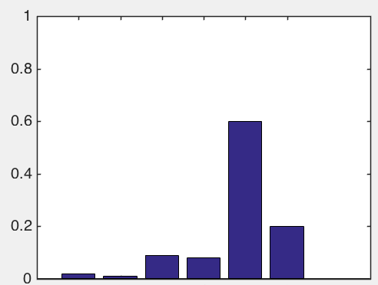
If the probabilities are [.02,.01,.09,.08,.6,.2]
H([.02,.01,.09,.08,.6,.2]) = 1.6900

Slide 22
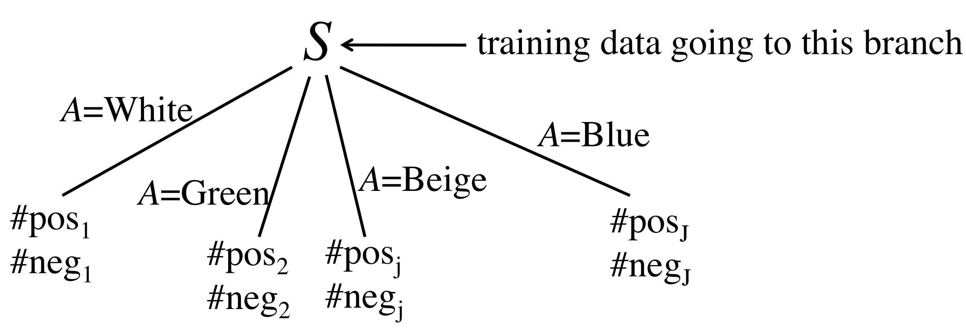
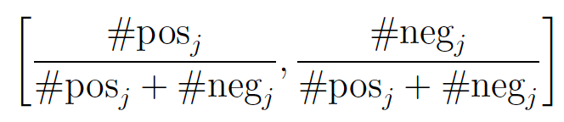
Splitting Criteria for Decision Trees: Information Gain
Rest of tree
The training probabilities in branch j are:
Notes:
SVMs started by addressing the question of what decision boundary to pick when all the points are correctly classified. This decision boundary looks pretty good right there. But how did I know not to choose this one?

Slide 23
Splitting Criteria for Decision Trees: Information Gain
Rest of tree
The training probabilities in branch j are:
Notes:
SVMs started by addressing the question of what decision boundary to pick when all the points are correctly classified. This decision boundary looks pretty good right there. But how did I know not to choose this one?

Slide 24
Splitting Criteria for Decision Trees: Information Gain
Rest of tree
The training probabilities in branch j are:
Notes:
SVMs started by addressing the question of what decision boundary to pick when all the points are correctly classified. This decision boundary looks pretty good right there. But how did I know not to choose this one?

Slide 25
Splitting Criteria for Decision Trees: Information Gain
Rest of tree
The training probabilities in branch j are:
[.08,.99] is good
[.50,.50] is bad
Notes:
Let’s say we’re doing binary classification, so positives and negatives only.

Slide 26
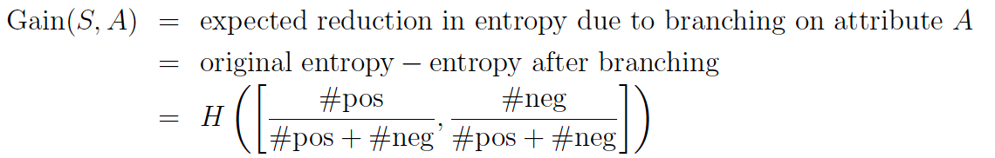
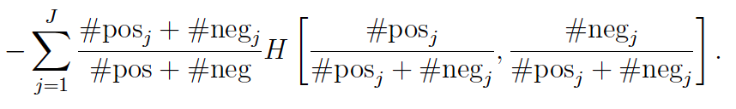
Splitting Criteria for Decision Trees: Information Gain
Notes:
Let’s say we’re doing binary classification, so positives and negatives only.

Slide 27
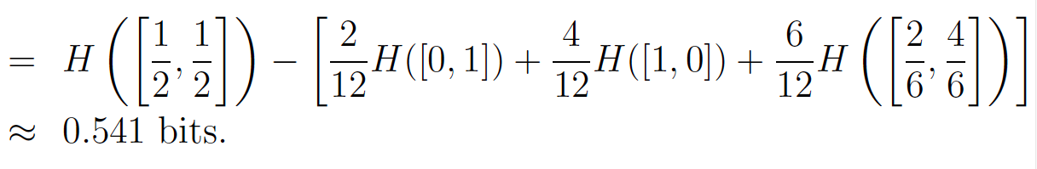
Splitting Criteria for Decision Trees: Information Gain
Gain(S,Guests)
Notes:
Let’s say we’re doing binary classification, so positives and negatives only.

Slide 28
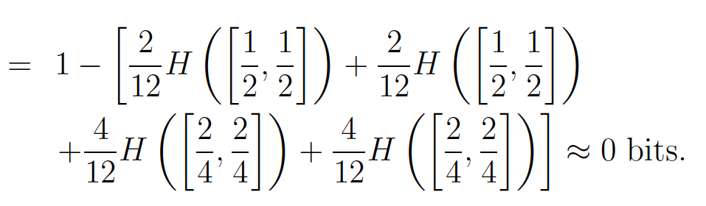
Splitting Criteria for Decision Trees: Information Gain
Gain(S,Genre)
Gain(S,Guests)
Notes:
Let’s say we’re doing binary classification, so positives and negatives only.

Slide 29
Standard Way to Build a Decision Tree
What I discussed was how C4.5 does splitting.
Start at the top of the tree.
Grow it by “splitting” features one by one. To split, look at how “impure” the node is.
Assign leaf nodes the majority vote in the leaf.
At the end, go back and prune leaves to reduce overfitting.
CART uses a similar criteria called Gini Index
CART uses minimal cost complexity pruning
Notes:
Once you’ve seen one splitting criteria you sort of get the idea, they are all very similar to information gain. They all have the same effect. Now there’s also the matter of pruning, which I thought would be somewhat repetitive to discuss here since I had gone through the splitting, but essentially the idea is that you calculate a quantity on the unpruned version and on the pruned version and you see which one is lower and split. In any case, luckily you never have to program any of that yourself, it’s all under the hood.

Slide 30
Pruning Criteria for Decision Trees: Minimal Cost Complexity
Each subtree is assigned a cost. Choose the subtree with the lowest cost
Notes:
Let’s say we’re doing binary classification, so positives and negatives only.

Slide 31
Pruning Criteria for Decision Trees: Minimal Cost Complexity
Each subtree is assigned a cost. Choose the subtree with the lowest cost
Misclassification
Error
Regularization
Each new leaf costs C.
That means each new leaf is worth the same as C misclassified points.
Notes:
So you will want to keep a leaf only if it has less than C errors. Otherwise it benefits you to remove the leaf. According to this criterion.

Slide 32
More on Decision Trees
There are decision trees for regression

Slide 33
Advantages of Decision Trees
Handles nonlinearities
Interpretable (at least CART)
Greedy, so very fast
Can easily handle imbalanced data by reweighting the points.
Disadvantages of Decision Trees
Not very interpretable without trading off accuracy
Greedy, so less accurate than other methods
Heuristic algorithm – not elegant
Tend to do poorly for imbalanced data, can’t even adjust the parameters.
Note
CART tends to be more interpretable but less accurate than C4.5, but C4.5 produces completely uninterpretable models by default.
Notes:
As you can tell, I really dislike decision trees. My own research group has been working for years on alternatives to decision trees that are not greedy, not heuristic, and are nicely accurate. Maybe I’ll get to teach you about those methods when we get out of the intro level. In any case, use decision trees, but beware.
One major advantage of decision trees that I’m going to talk about shortly is the fact that you can boost them. In other words, you can combine a bunch of them to build something that is pretty robustly accurate, which is a boosted decision tree.

Slide 34
04 | Boosting
Cynthia Rudin | MIT Sloan School of Management

Slide 35
Boosting Motivation
Question of Kearns: Can you turn a “weak” learning algorithm (that is barely better than random guessing) into a “strong” learning algorithm (whose error rate is arbitrarily close to 0)?

Slide 36
Boosting Motivation
Question of Kearns: Can you turn a “weak” learning algorithm (that is barely better than random guessing) into a “strong” learning algorithm (whose error rate is arbitrarily close to 0)?
We could ask the algorithm to create a lot of classifiers and figure out how to combine them… but if we give the algorithm the same input each time, it will produce the same answer, not a lot of different classifiers.
Notes:
We have to figure out how to ask the weak learning algorithm to create lots of different classifiers.

Slide 37
Boosting Motivation
Schapire and Freund’s answer:
Reweight the data in many ways
Use the weak learning algorithm to create a weak classifier for each (reweighted) dataset
Compute a weighted average of the weak classifiers.
Notes:
There were several boosting algorithms, but the most successful one is called AdaBoost, and I’ll talk about that one here. First I want to talk about the application that made boosting famous, which is the famous example of Viola and Jones in computer vision.

Slide 38
Weak classifiers used by Viola and Jones
Subtract the white areas from the black ones

Slide 39

Weak classifiers used by Viola and Jones
Subtract the white areas from the black ones
Notes:
Steve elston

Slide 40
Weak classifiers used by Viola and Jones
Subtract the white areas from the black ones
Doesn’t detect anything
Black and white areas are very similar
Notes:
Steve elston

Slide 41
Weak classifiers used by Viola and Jones
Subtract the white areas from the black ones
Doesn’t detect anything
Black and white areas are very similar
Notes:
Steve elston

Slide 42
Weak classifiers used by Viola and Jones
Subtract the white areas from the black ones
Now it detects!
Notes:
Steve elston

Slide 43
Weak classifiers used by Viola and Jones
Subtract the white areas from the black ones
Weak classifiers
Detects eyes!
Notes:
But check it out. If you put that first little weak classifier right there, the answer will be big! Because there’s a huge difference between the white area, which is lighter, and the black area, which is darker. The detector is looking for the difference between the dark eyes and the part of the face below that. And the second little detector there is looking for two black areas separated by a white area, which is the person’s nose. Now each of these little detectors by itself… not so useful. Put them together, really useful. Now you can detect eyes above cheeks, you can get the space between the eyes, and so on.

Slide 44
Weak classifiers used by Viola and Jones
Subtract the white areas from the black ones
Weak classifiers
Detects eyes!
Notes:
But check it out. If you put that first little weak classifier right there, the answer will be big! Because there’s a huge difference between the white area, which is lighter, and the black area, which is darker. The detector is looking for the difference between the dark eyes and the part of the face below that. And the second little detector there is looking for two black areas separated by a white area, which is the person’s nose. Now each of these little detectors by itself… not so useful. Put them together, really useful. Now you can detect eyes above cheeks, you can get the space between the eyes, and so on.
The eye region is darker than the upper-cheeks.
The nose bridge region is brighter than the eyes.

Slide 45

Weak classifiers used by Viola and Jones
Used hundreds of thousands of these weak classifiers at all different scales
Notes:
Because of course faces can be large in an image or they can be small. Now these are all *weak* classifiers since obviously none of them are really that much better than random guessing, but they are, in fact, better than random, which means if you combine them, you could get something really good.

Slide 46
Weak classifiers used by Viola and Jones
Used hundreds of thousands of these weak classifiers at all different scales
Notes:
And obviously the goal is to put these little boxes around people’s faces.

Slide 47
AdaBoost Pseudocode
Assign observation i the weight of d_{1i}=1/n (equal weights).
For t=1:T
Train weak learning algorithm using data weighted by d_{ti}=1/n. This produces weak classifier h_{t}.
Choose coefficient α_{t}.
Update weights:
Z_{t} is a normalization factor.
End
Output the final classifier:
Notes:
https://www.cs.princeton.edu/courses/archive/spring07/cos424/papers/boosting-survey.pdf
I’ll tell you how to get the alpha’s later on.
The effect of the weight update is that it increases the weights on the misclassified points and decreases the weights on the correctly classified points.

Slide 48
Boosting Example
All points start with equal weights.
(Credit: Example adapted from Freund and Schapire)
Notes:
Our weak classifiers are only allowed to be lines that are either horizontal or vertical in this example.

Slide 49
Boosting Example
Run the weak learning algorithm to get a weak classifier.
(Credit: Example adapted from Freund and Schapire)
Notes:
Ok which points were misclassified? The three up there.

Slide 50
Boosting Example
Increase the weights on the misclassified points, decrease the weights on the correctly classified points.
(Credit: Example adapted from Freund and Schapire)
Notes:
So it basically has to get those three points right on the next round.
Before I do the next round, I have to choose the coefficient for this weak classifier, which is going to determine how much it contributes to the final combined classifier. I will tell you how to get it shortly officially, but I’ll tell you now that the weight depends on how well the weak classifier performs on that round. So here, the weak classifier missed three points that had reasonable weights, so it won’t get a high coefficient.
So let’s do the next round.

Slide 51
Boosting Example
(Credit: Example adapted from Freund and Schapire)
Notes:
So it basically has to get those three points right on the next round. So let’s do the next round.

Slide 52
Boosting Example
Run the weak learning algorithm to get a weak classifier for the weighted data.
(Credit: Example adapted from Freund and Schapire)
Notes:
Yes it gets those points right this time, but it sacrifices the three negative ones below it.

Slide 53
Boosting Example
Increase the weights on the misclassified points, decrease the weights on the correctly classified points.
(Credit: Example adapted from Freund and Schapire)
Notes:
See this time the coefficient is higher because it got those three positives right that had high weights.

Slide 54
Boosting Example
Increase the weights on the misclassified points, decrease the weights on the correctly classified points.
(Credit: Example adapted from Freund and Schapire)
Notes:
Let’s see what it does now.

Slide 55
Boosting Example
Increase the weights on the misclassified points, decrease the weights on the correctly classified points.
(Credit: Example adapted from Freund and Schapire)
Notes:
Now it got all the high weighted points correct so this classifier gets to contribute a lot to the final combined one.

Slide 56
Boosting Example
H=sign(.42 + .66 + .93 )
(Credit: Example adapted from Freund and Schapire)

Slide 57
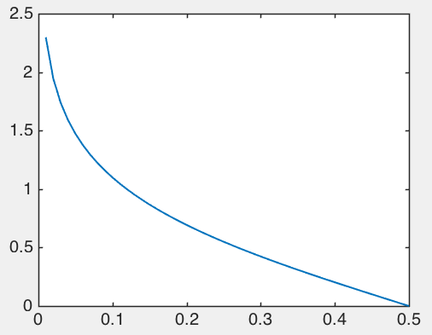
AdaBoost’s Coefficients Update

Slide 58
Coordinate Descent
Notes:
I want to give you another perspective on AdaBoost because the framework of boosting is much more general actually than what I just presented, which was sort of a classical introduction to adaboost for binary classification with binary weak classifiers. I didn’t explain where the formula for the coefficients comes from, and I kind of want you to understand that. In order to provide you that extra explanation, I need to tell you what coordinate ascent is. The idea with coordinate descent is that you must go along the coordinates. For instance if you’re on a street, you cannot cut through a house. You have to only go in certain directions.

Slide 59
Coordinate Descent
Notes:
Let’s say that you’re at that blue dot

Slide 60
Coordinate Descent
For t=1:T
Choose direction h_{t}.
Choose how far to go in that direction α_{t}.
End
Output the final position:

Slide 61
Coordinate Descent
Notes:
I want to give you another perspective on AdaBoost because the framework of boosting is much more general actually than what I just presented, which was sort of a classical introduction to adaboost for binary classification with binary weak classifiers. I didn’t explain where the formula for the coefficients comes from, and I kind of want you to understand that. In order to provide you that extra explanation, I need to tell you what coordinate descent is.

Slide 62
AdaBoost Pseudocode
Assign observation i the weight of d_{1i}=1/n (equal weights).
For t=1:T
Train weak learning algorithm using data weighted by d_{ti}=1/n. This produces weak classifier h_{t}.
Choose coefficient α_{t}.
Update weights:
Z_{t} is a normalization factor.
End
Output the final classifier:
Notes:
We can arrive at this code another way, using the idea of coordinate descent. Let me first tell you what the hill is that AdaBoost is climbing. Actually in the picture we’re climbing up but AdaBoost climbs down into a valley, so it’s coordinate descent rather than coordinate ascent.

Slide 63
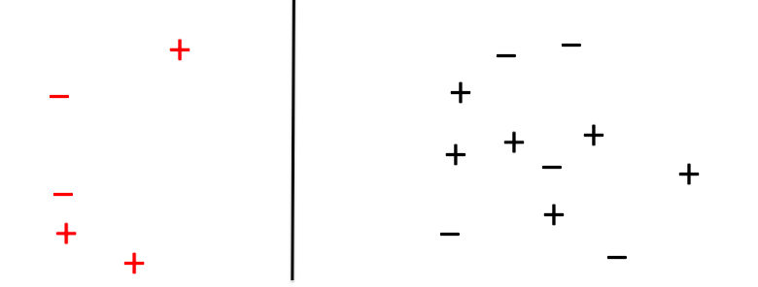
“sort of correct”
“very correct”
“sort of wrong”
“very wrong”
Notes:
I’m just going to write this function another way, which is like this. So we lose one point if yf is less than 0, and otherwise we lose no points. This is the classic 0-1 loss, just tells you whether your classifier is right or wrong. This is called a loss function. There are other loss functions too. This one is nice but it’s problematic because it’s not smooth, and we have issues with things that are not smooth in machine learning. Let’s try some more loss functions. While we’re doing this…
----
Why are those equal?
Think about it. There are only a few possibilities. If y is positive and f is positive, then we don’t make a mistake, and the top is 0. yf is positive, not negative, so the bottom is 0.
If y and f are both negative, then we don’t make a mistake, the top is 0 and and yf is positive again.
If y is positive and f is negative, then we make a mistake, we lose a point up here, and we also lose a point down here because y times f is negative.
Same thing if y is negative and f is positive.
So these logical expressions are equal to each other.

Slide 64
“sort of correct”
“very correct”
“sort of wrong”
“very wrong”
Exponential Loss

Slide 65
Exponential Loss

Slide 66
Coordinate Descent
A
α
Notes:
I want to give you another perspective on AdaBoost because the framework of boosting is much more general actually than what I just presented, which was sort of a classical introduction to adaboost for binary classification with binary weak classifiers. I didn’t explain where the formula for the coefficients comes from, and I kind of want you to understand that. In order to provide you that extra explanation, I need to tell you what coordinate descent is.

Slide 67
Choose steepest direction:

Slide 68
Choose steepest direction:
The direction is that of the lowest weighted error.
Notes:
The “direction” is the weak classifier chosen by the weak learning algorithm.

Slide 69
Coordinate Descent
α
A
Notes:
So it’s actually choosing the steepest route up the hill.

Slide 70
Choose steepest direction.
The direction is that of the lowest weighted error.
Notes:
The “direction” is the weak classifier chosen by the weak learning algorithm. So this step is done exactly by the weak learning algorithm. And if it doesn’t choose exactly the best weak classifier, that’s ok. It still provably works under most conditions. Now we have to choose how far we want to walk along that direction.

Slide 71
Choose steepest direction.
The direction is that of the lowest weighted error.
Choose coefficient α_{t}.
Notes:
That’s the same as choosing the coefficient alpha.

Slide 72
Coordinate Descent
A
α
Notes:
Now how far do we really want to walk up the hill? We want to keep going all the way up the hill if we can, until it doesn’t benefit us to go any farther. So we want to solve a 1 dimensional optimization problem, where is the maximizer of the function just along that one dimension that we’ve chosen.

Slide 73
Choose steepest direction.
The direction is that of the lowest weighted error.
Choose coefficient α_{t}.

Slide 74
Choose steepest direction.
The direction is that of the lowest weighted error.
Choose coefficient α_{t}.
Update weights – this just helps with the steepest descent computation for the next round.

Slide 75
AdaBoost Pseudocode
Assign observation i the weight of d_{1i}=1/n (equal weights).
For t=1:T
Train weak learning algorithm using data weighted by d_{ti}=1/n. This produces weak classifier h_{t}.
Choose coefficient α_{t}.
Update weights:
Z_{t} is a normalization factor.
End
Output the final classifier:
Notes:
So hopefully that gives you a little more perspective on why Adaboost works. It’s just doing coordinate descent on the exponential loss. The weak learning algorithm tells you what direction to go in (the steepest one), and the coefficients are just how far we want to move in that direction, and the weight update just makes the computation of the best direction easier for the next round.

Slide 76
Train weak learning algorithm using data weighted by d_{ti}=1/n. This produces weak classifier h_{t}.
Choose coefficient α_{t}.
Update weights:
Any machine learning algorithm can be a weak learning algorithm
Choose coefficient α_{t}.
Update weights:
Boosted Decision Trees
Notes:
In particular decision trees make great weak learning algorithms. BDT are probably the most reliable classification method out there right now. There was a study done by Caruana and Niculescu Mizil several years ago, and they declared BDT the best one.

Slide 77
What’s the difference between Boosted Decision Trees and Decision Forests?
Decision Forests
compute many trees from different subsets of data and features
average them (bagging).
Boosted Decision Trees
reweight the data to generate different trees.
The combination minimizes training error (coordinate descent on the exponential loss).
Notes:
They have very different sorts of philosophies even though what you end up with at the end is pretty similar, which is a bunch of overfitted heuristic trees, combined in some way. The philosophy behind decision forests is to average everything to reduce variance. The approach behind boosting tries to minimize bias and make the model more accurate, but ends up reducing variance anyway because the trees that it generates tend to be diverse because of all the reweighting. Anyway, I would say those are two of the most powerful black box machines learning methods out there right now.

Slide 78
The coordinate descent view of AdaBoost provides us with a principled way of creating other machine learning algorithms.
“Gradient Boosting” or “Leveraging”

Slide 79
The coordinate descent view of AdaBoost provides us with a principled way of creating other machine learning algorithms.
“Gradient Boosting” or “Leveraging”

Slide 80
The coordinate descent view of AdaBoost provides us with a principled way of creating other machine learning algorithms.
“Gradient Boosting” or “Leveraging”

Slide 81
Summary of Boosting
Powerful, nonlinear, black-box
Originated to reweight the “hard to classify” observations at each round
Turns out it is coordinate descent on the exponential loss
Idea of using coordinate descent generalizes to many loss functions (classification, regression) and with regularization.
Notes:
Rated at the top of the ML algorithms on empirical performance. Kind of slow.

Slide 82
04 | Decision Forests
Cynthia Rudin | MIT Sloan School of Management

Slide 83
Decision Forests
Complex and powerful prediction tool
Black-box
Uses similar idea to boosted decision trees: if you average many uncorrelated yet accurate models, it reduces variance.
Notes:
Leading to better generalization. Let’s say you want to know whether you should get surgery. You ask your doctor, and she says you should get it. Do you trust that? Even if the doctor is good you might not trust that one doctor. What if instead you could ask 10 equally good doctors all trained at different places and 8 of them said you should get it. Perhaps that’s much more trustworthy than just asking the one doctor. That’s the idea behind decision forests.

Slide 84
Decision Forests
Example: Will the customer wait for a table at a restaurant?
OthOptions: Other options, True if there are restaurants nearby.
Weekend: This is true if it is Friday, Saturday or Sunday.
Area: Does it have a bar or other nice waiting area to wait in?
Plans: Does the customer have plans just after dinner?
Price: This is either $, $$, $$$, or $$$$
Precip: Is it raining or snowing?
Genre: French, Mexican, Thai, or Pizza
Wait: Wait time estimate: 0-5 min, 5-15 min, 15+
Crowded: Whether there are other customers (no, some, or full)
Credit: Adapted from Russell and Norvig

Slide 85
Crowded?
Crowded?
Full
None
None
Full
Some
OthOptions?
Some
No
Yes
No
Yes
Plans?
No
Yes
Genre?
No
Yes
No
Price?
French
No
$$$$
$
Mex
Pizza
$$$
$$
Chinese
Yes
Yes
No
Yes
Yes
No
No
Wait time
No
30+
0-5
5-15
New observation:
Mexican, $$, Full, 5-15 min No plans, No other options
No
Yes
Crowded?
No
Yes
Price?
$$$$
Yes
$$$
$$
$
Majority Vote: Yes
No
Yes
No
Yes

Slide 86
Decision Forests
A bootstrap sample of size n: Draw n points with replacement at random from the training data.
(So you have some repeated points, and that’s ok.)

Slide 87
Decision Forests
For t=1 to T:
Draw a bootstrap sample of size n from the training data.
Grow a tree (tree_{t}) using this splitting and stopping procedure:
Choose m features at random (out of p)
Evaluate the splitting criteria on all of them
Split on the best feature
If the node has less than n_{min} then stop splitting.
Output all the trees.
To predict on a new observation x, use the majority vote of the trees on x.

Slide 88
Decision Forests
Make trees diverse, which reduces variance
Comparison with decision trees:
Bootstrap resamples
Splitting considers only m possible (randomly chosen) features
No pruning
Majority vote of several trees is used to make predictions
Make trees fit more tightly, reduces bias
Why?
Notes:
What’s up with these choices. So the reason for the bootstrap samples and considering m features is to make all the trees look different from each other.

Slide 89
Decision Forests: Measuring Variable Importance
Let us measure the “importance” of variable j.
Take the data not used to construct tree_{t}. Call it “out-of-bag”, OOB_{t}.
Compute error_{t}, using model tree_{t} on data OOB_{t}.
Now randomly permute only the j^{th} feature values.
Notes:
Kind of a neat way to measure how important a variable is.

Slide 90
Decision Forests: Measuring Variable Importance
Let us measure the “importance” of variable j.
Take the data not used to construct tree_{t}. Call it “out-of-bag”, OOB_{t}.
Compute error_{t}, using model tree_{t} on data OOB_{t}.
Now randomly permute only the j^{th} feature values.
Reorder me!
OOB
Notes:
Kind of a neat way to measure how important a variable is.

Slide 91
Decision Forests: Measuring Variable Importance
Let us measure the “importance” of variable j.
Take the data not used to construct tree_{t}. Call it “out-of-bag”, OOB_{t}.
Compute error_{t}, using model tree_{t} on data OOB_{t}.
Now randomly permute only the j^{th} feature values.
Reorder me!
Notes:
Kind of a neat way to measure how important a variable is.

Slide 92
Decision Forests: Measuring Variable Importance
Let us measure the “importance” of variable j.
Take the data not used to construct tree_{t}. Call it “out-of-bag”, OOB_{t}.
Compute error_{t}, using model tree_{t} on data OOB_{t}.
Now randomly permute only the j^{th} feature values. Call this OOB_{t,permuted}.
Notes:
Kind of a neat way to measure how important a variable is.

Slide 93
Decision Forests: Measuring Variable Importance
Let us measure the “importance” of variable j.
Take the data not used to construct tree_{t}. Call it “out-of-bag”, OOB_{t}.
Compute error_{t}, using model tree_{t} on data OOB_{t}.
Now randomly permute only the j^{th} feature values. Call this OOB_{t,permuted}.
Compute error_{t,permuted}, using model tree_{t} on data OOB_{t,permuted}.
The “raw importance” of variable j is then the average over trees of the difference:
Notes:
Kind of a neat way to measure how important a variable is.

Slide 94
Decision Forests for Regression
For t=1 to T:
Draw a bootstrap sample of size n from the training data.
Grow a tree (tree_{t}) using this splitting and stopping procedure:
Choose m features at random (out of p)
Evaluate the splitting criteria on all of them
Split on the best feature
If the node has less than n_{min} then stop splitting.
Output all the trees.
To predict on a new observation x, use the average vote of the trees on x.

Slide 95
Decision Forests
Advantages
Complex and powerful prediction tool, highly nonlinear
Disadvantages
Black-box
Tends to overfit unless tuned carefully (not always intuitive with the R package)
Slow
Notes:
I think RF is pretty neat. You grow a whole bunch of totally overfitted heuristic models and average their votes all together. How cool is that?

